Slide 1
Cybersecurity as an Evolving Host-Parasite System
Russell C. Thomas
russell.thomas@meritology.com
@MrMeritology
exploringpossibilityspace.blogspot.com
Mathew Woodyard
mat@matwoodyard.com

Slide 2
Institutional Innovation??
[rework this to be a “what this is not” slide?]
(Radical) alternatives to cyber insurance
Information sharing, reporting, inspection
Risk scoring, rating, and reporting
…

Slide 3
Other Treatments & Institutions
[move to front?]
Varieties of ignorance, error, and uncertainty
Social imitation, information sharing, and “best practices”
Investment policies: two levels
Capabilities
Infrastructure
Host-parasite dynamics
Incentive instruments (incl. insurance)

Slide 4
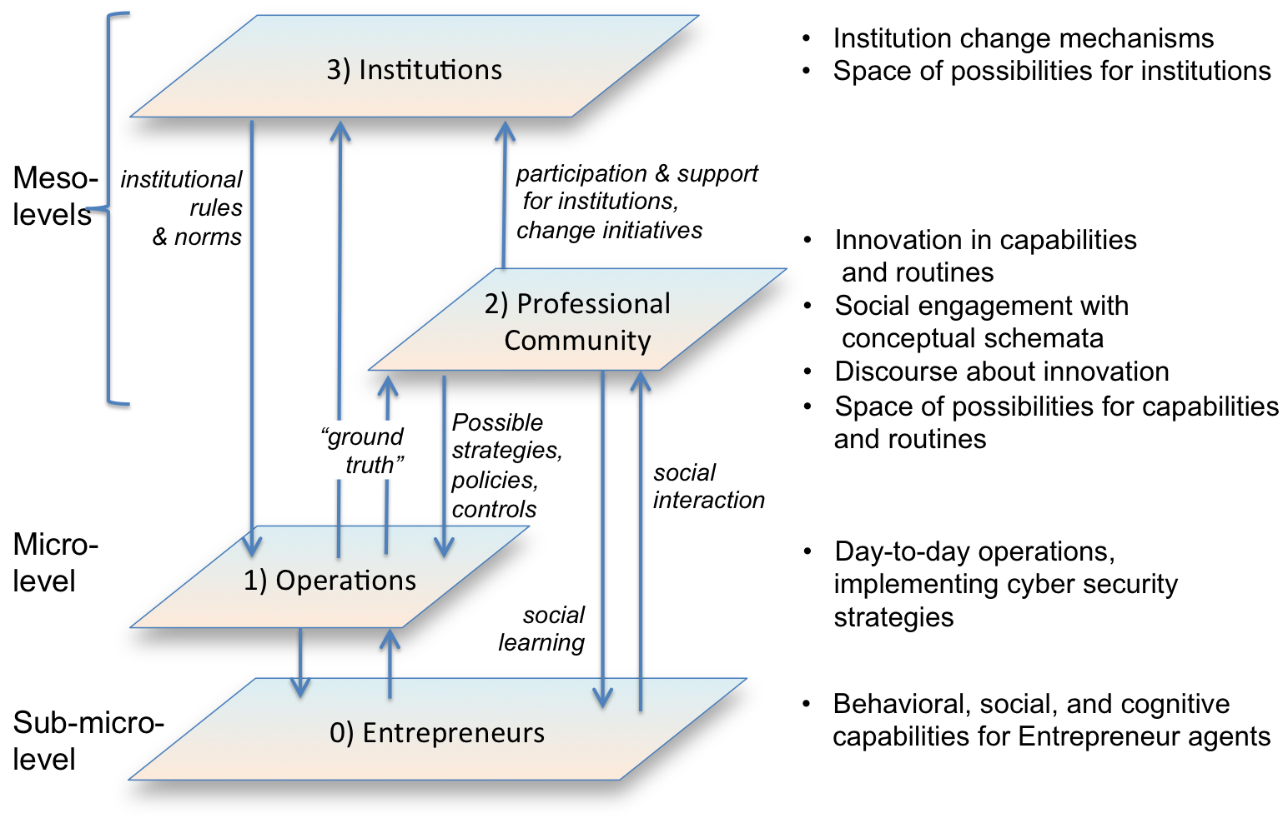

Slide 5
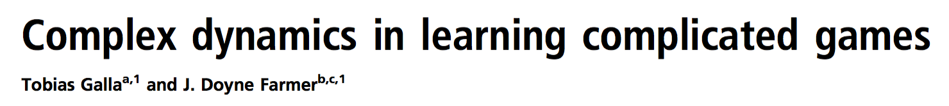
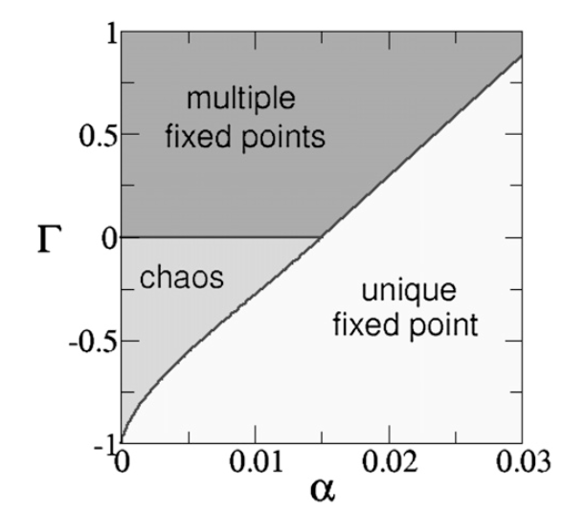
Foundation: Random Complicated Games
with Experience-weighted Learning
Notes:
One range: chaotic, never reach eq
Multiple fixed: multiple eq
Unique fixed point: one and only one eq

Slide 6
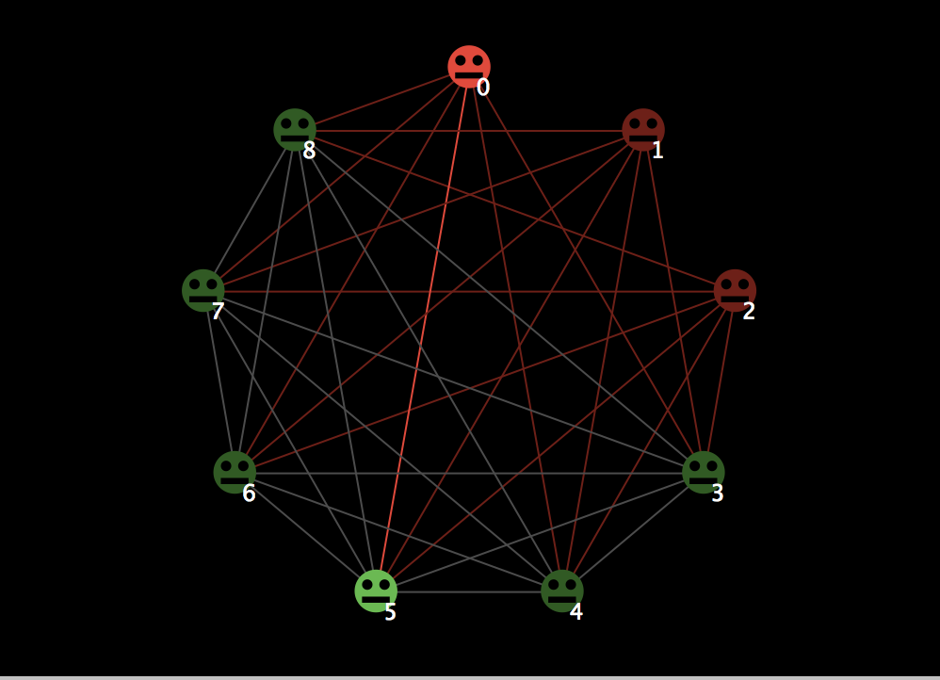

Slide 7
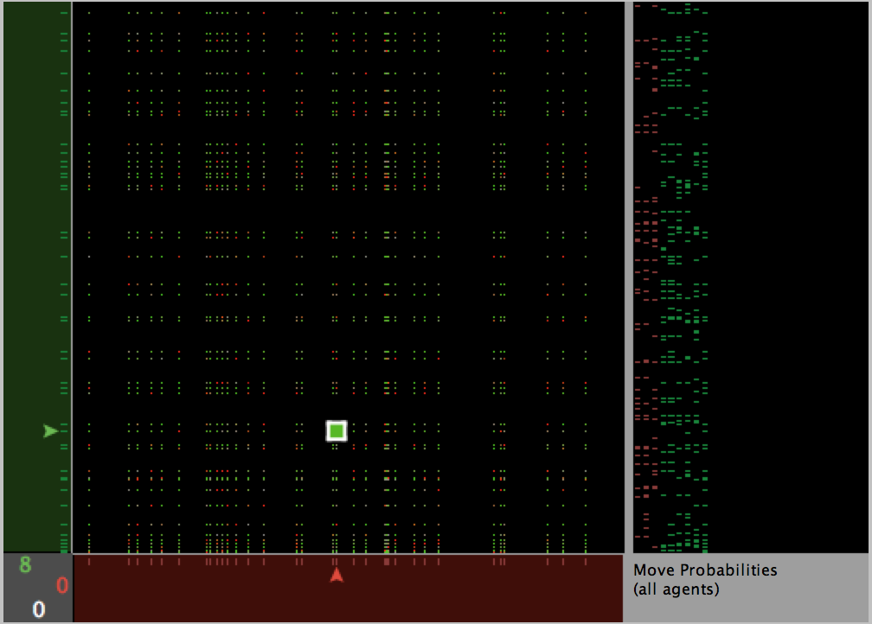

Slide 8
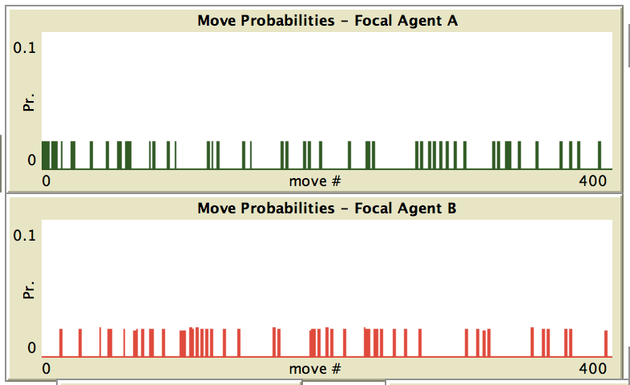
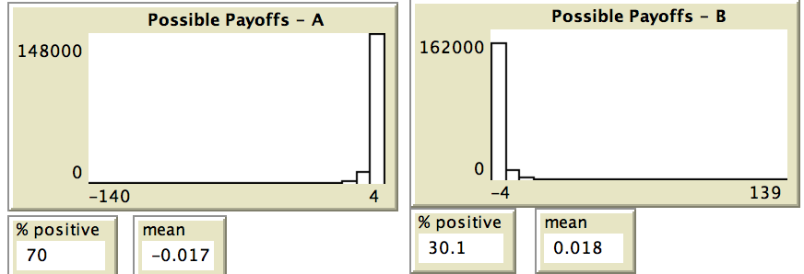
t = 0

Slide 9
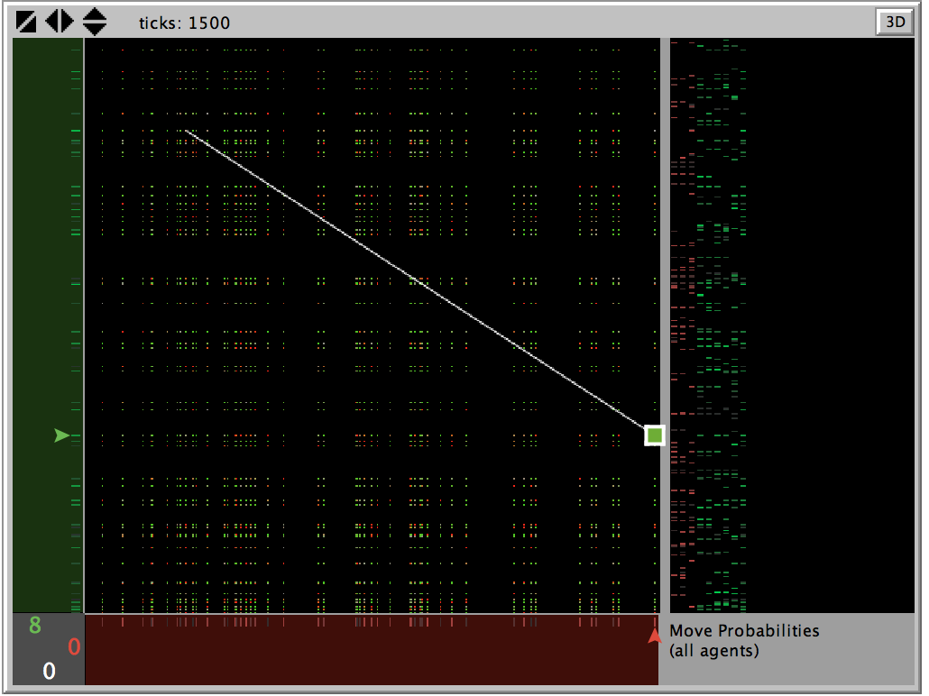

Slide 10
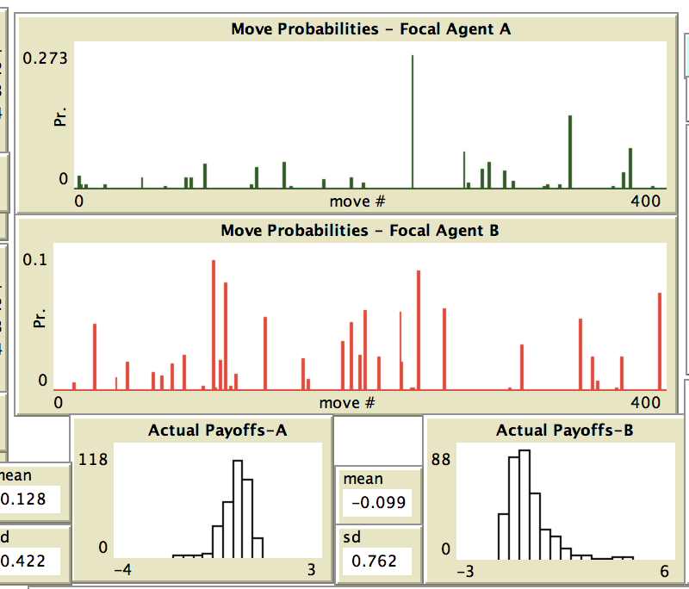
t = 1500

Slide 11
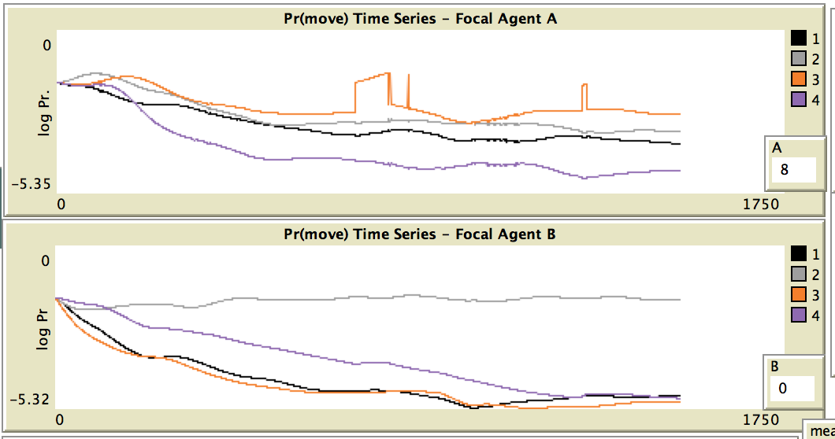
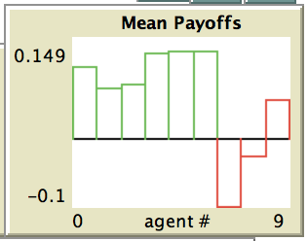

Slide 12
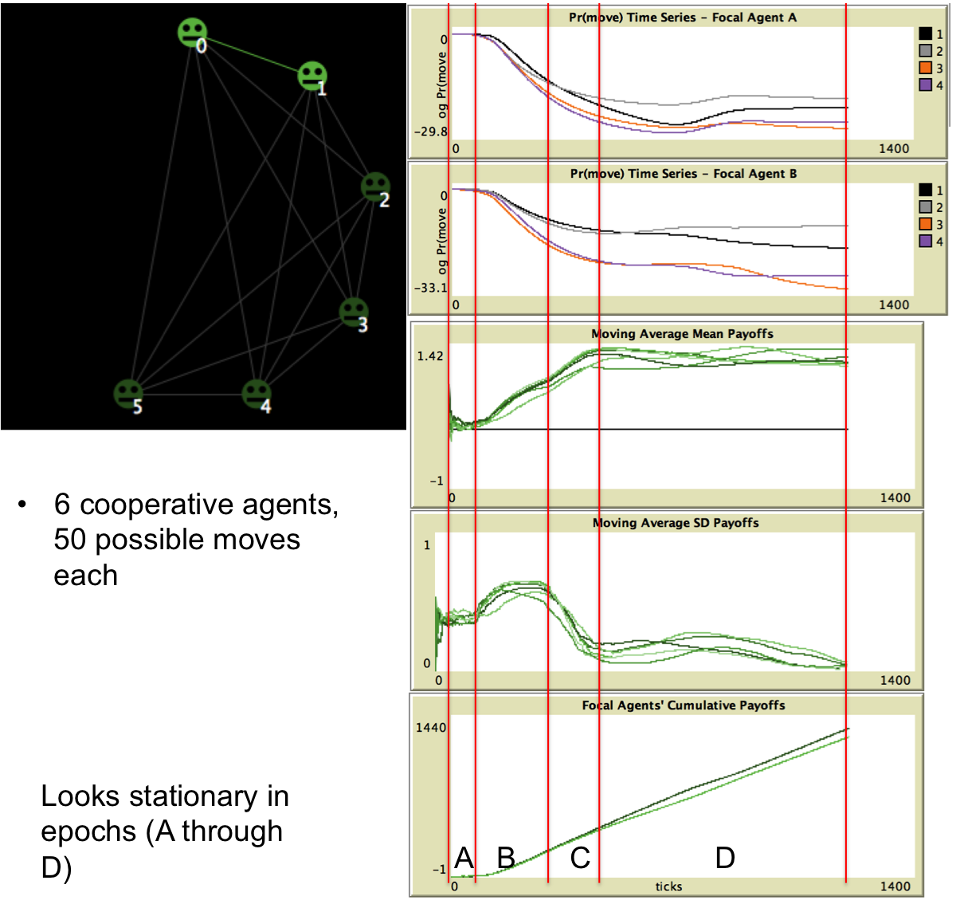
FIXED
POINT
(Equilibrium)

Slide 13
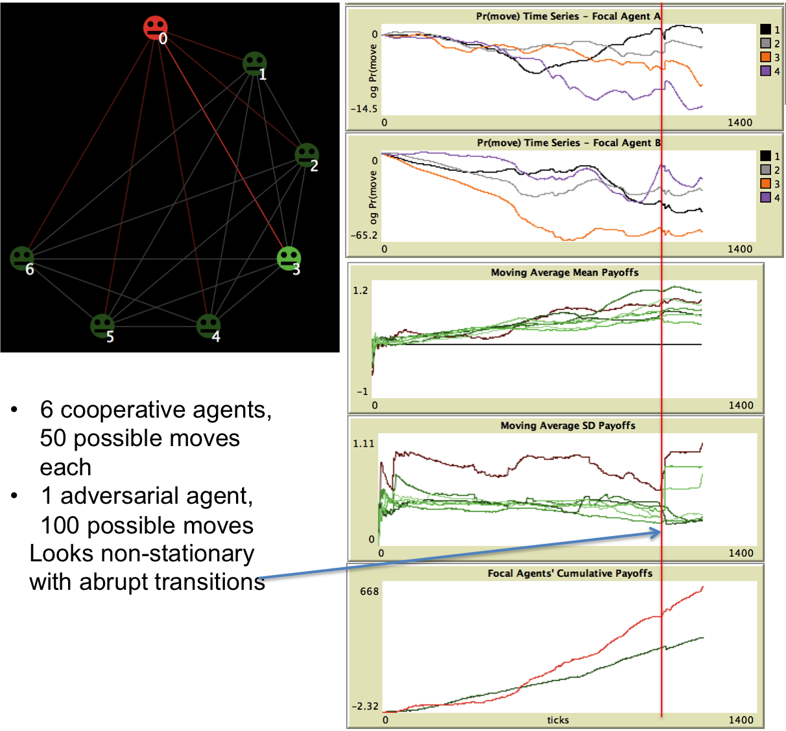
Chaos
(No Equilibrium)

Slide 14
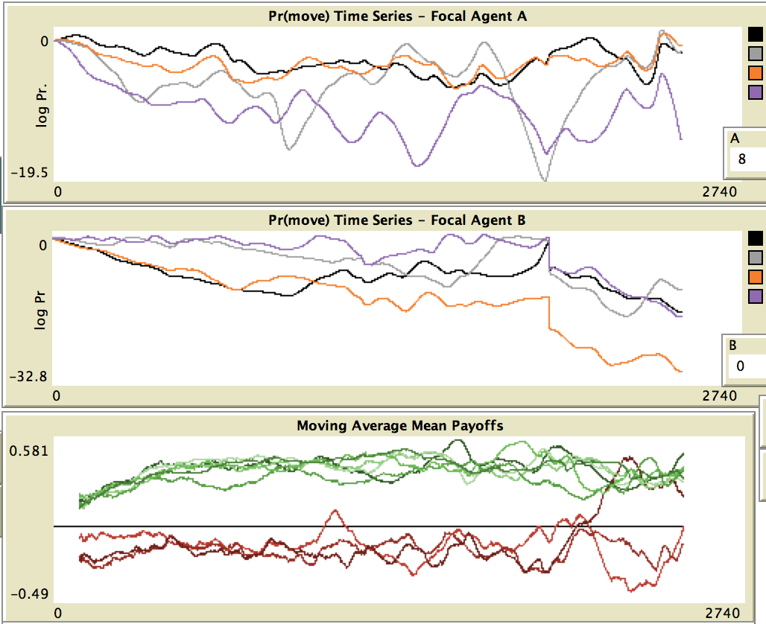
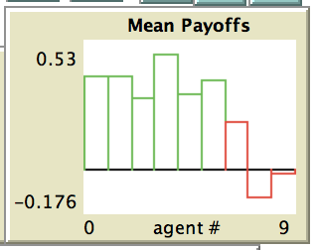
t = 2500
Treatment: Novelty (Red)
Regime Change
One Attacker
Starts to Thrive
Green Agents
Dominate Initially

Slide 15
Russell C. Thomas
russell.thomas@meritology.com
@MrMeritology
exploringpossibilityspace.blogspot.com
Mathew Woodyard
mat@matwoodyard.com

